Slide 1

Sprint 4- Final
Integration of Data Catalog with Content Search Technologies
Team Mindbots

Slide 2

Team Mind Bots

Slide 3
Key Features of Data Catalog and Content Search Technologies
Data Catalog | Content Search
Metadata Management | Keyword Search
Data Lineage Tracking | Faceted Search
Data Profiling and Data Quality | Ability to apply ML
Data Collaboration | Cross Platform Search
Data Security | Content Analytics
Integration with Multiple data sources

Slide 4
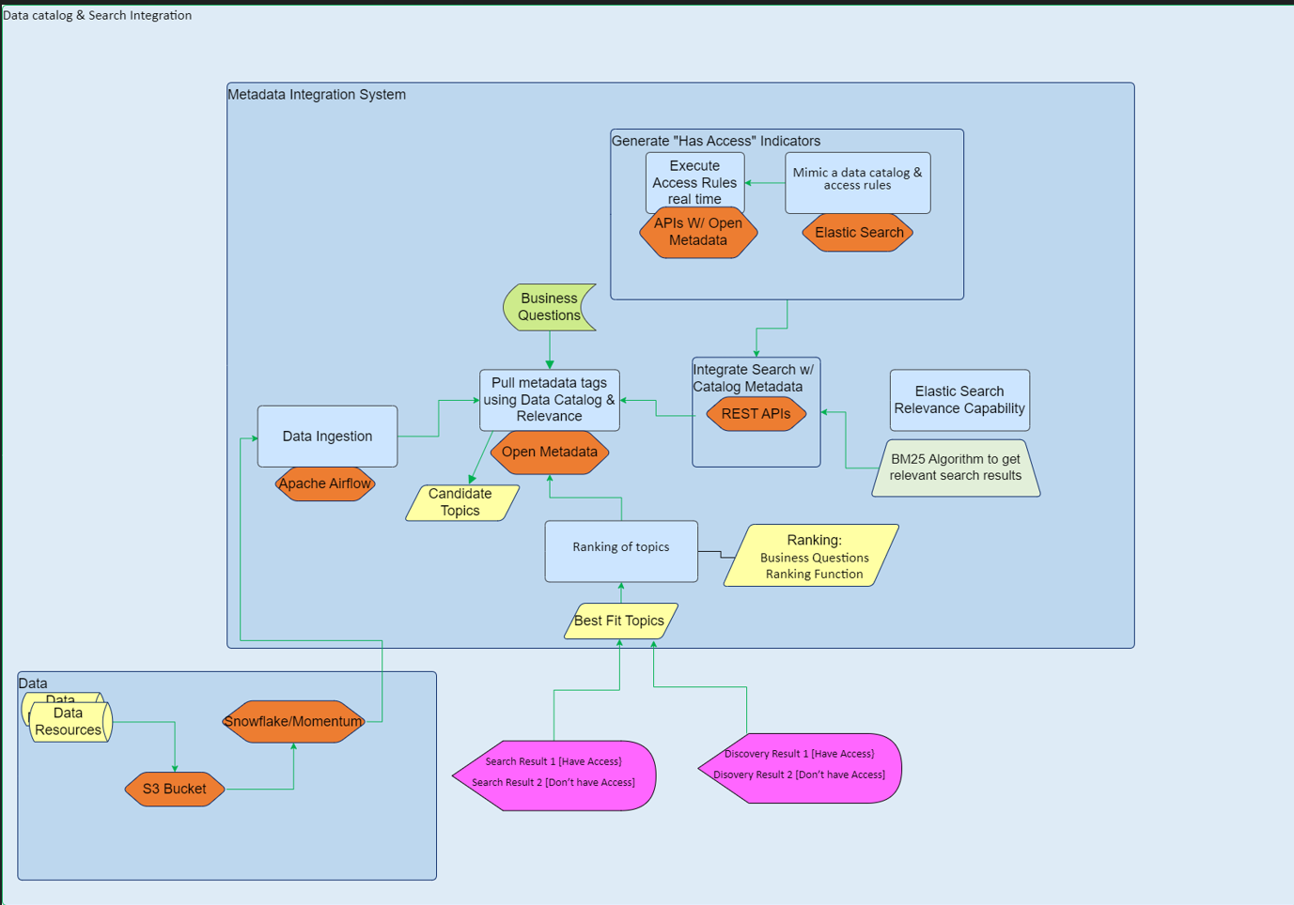
architecture :

Slide 5






Tools Used
Data Catalog : Open Metadata
Database: Snowflake
Storage : S3
Content Search : Elastic Search Engine
Cloud Services: Amazon AWS
Ingestion: Airflow

Slide 6
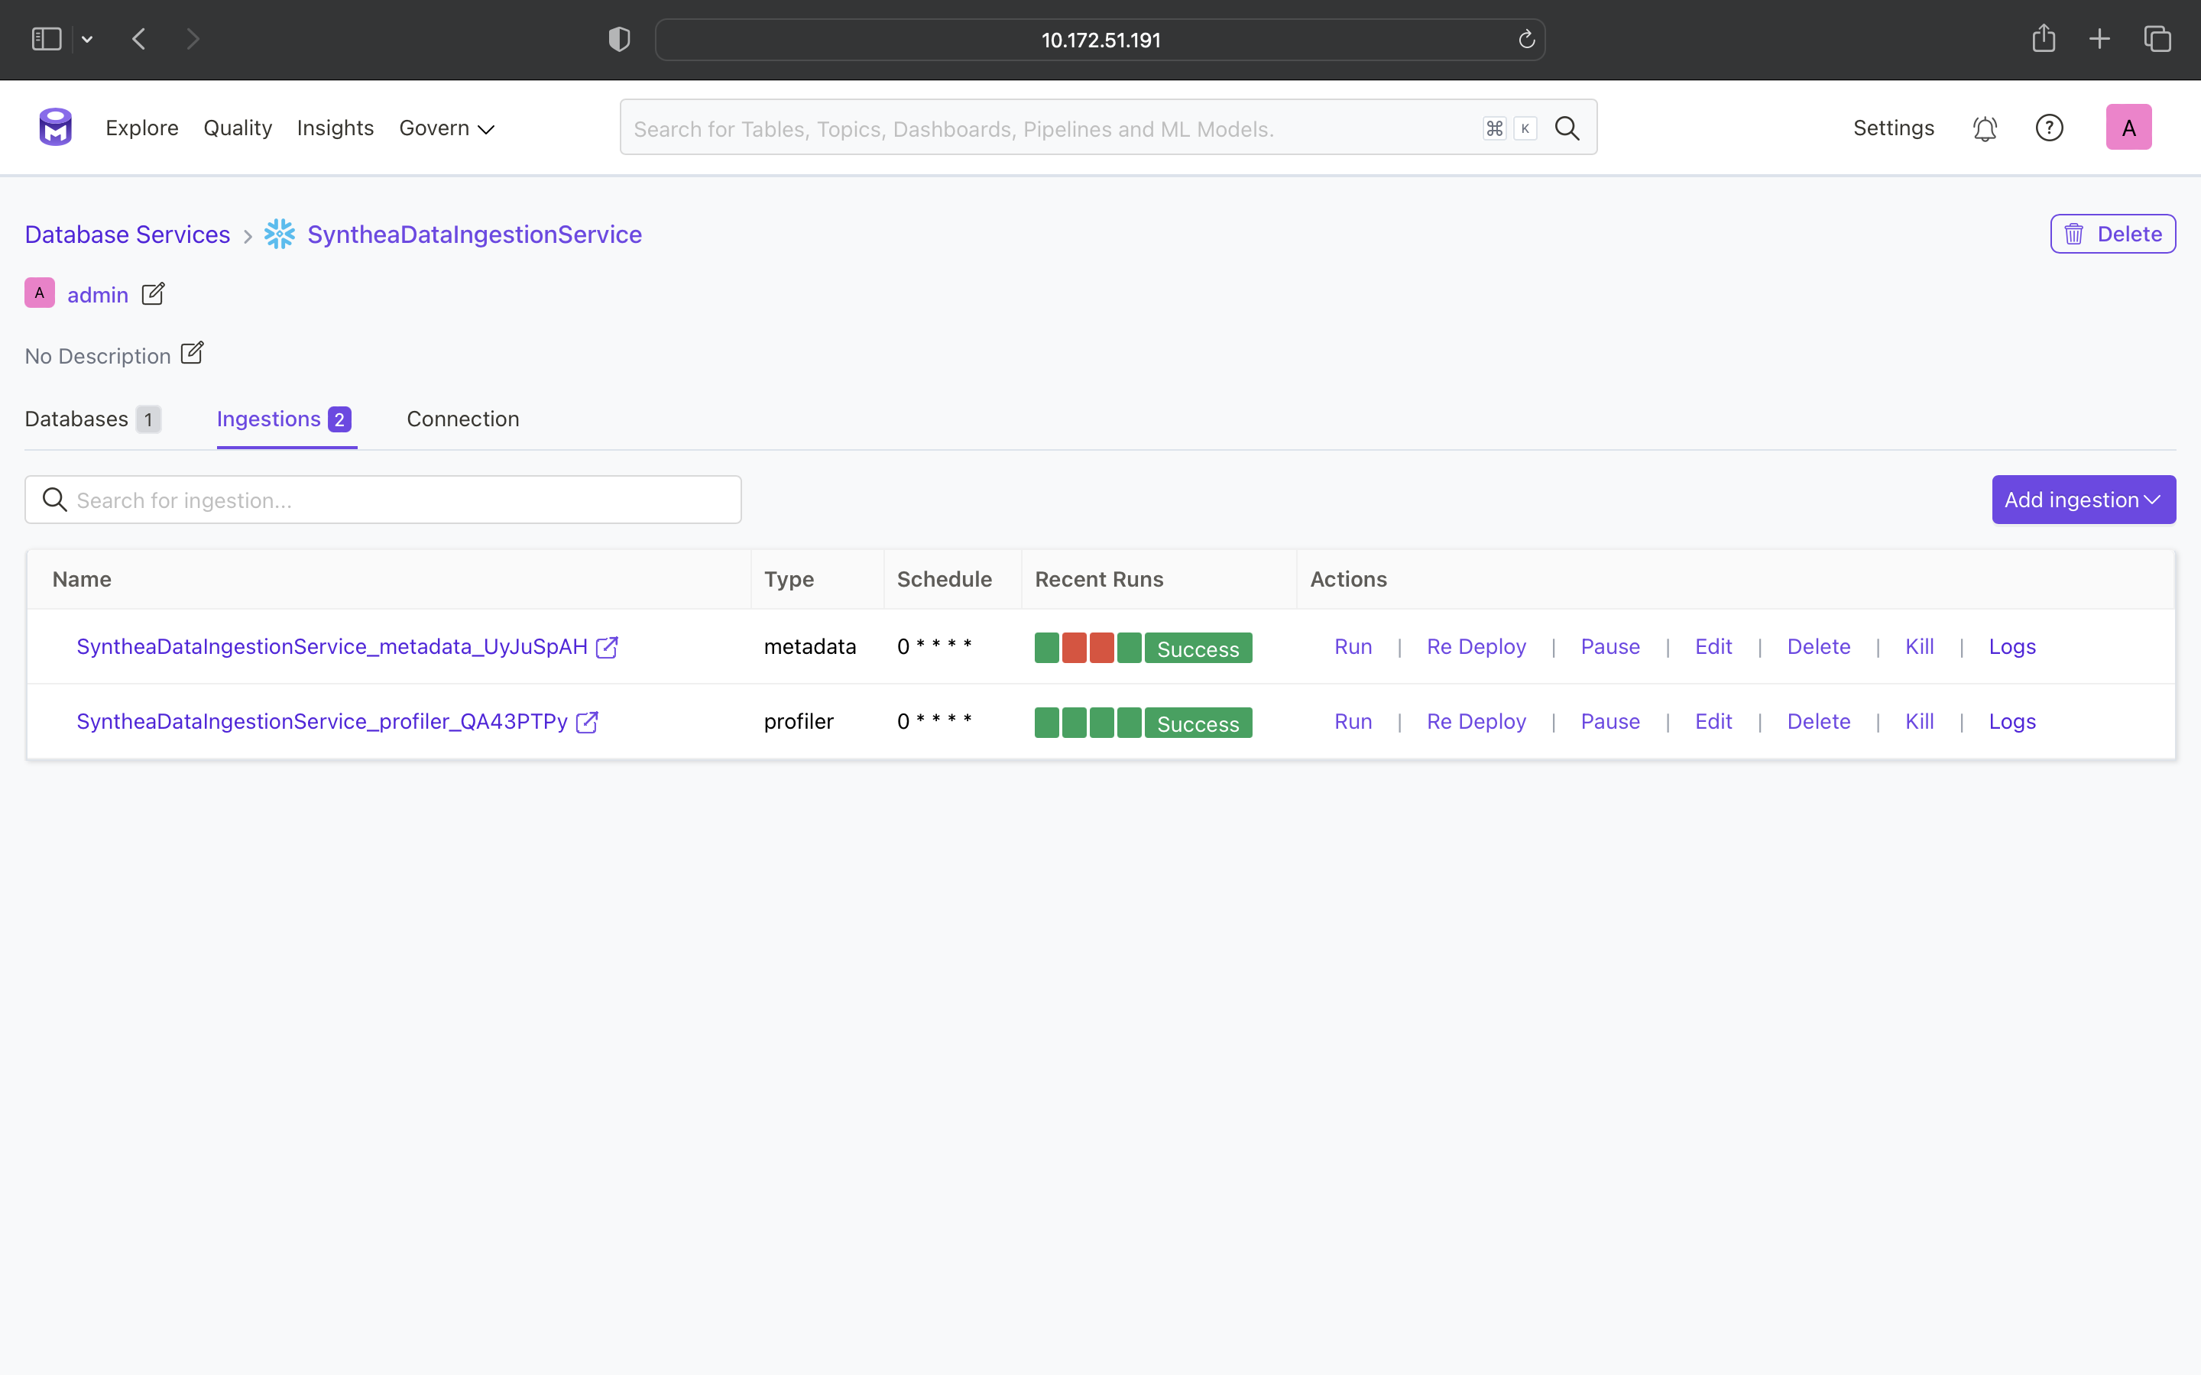
Data Ingestion

Slide 7
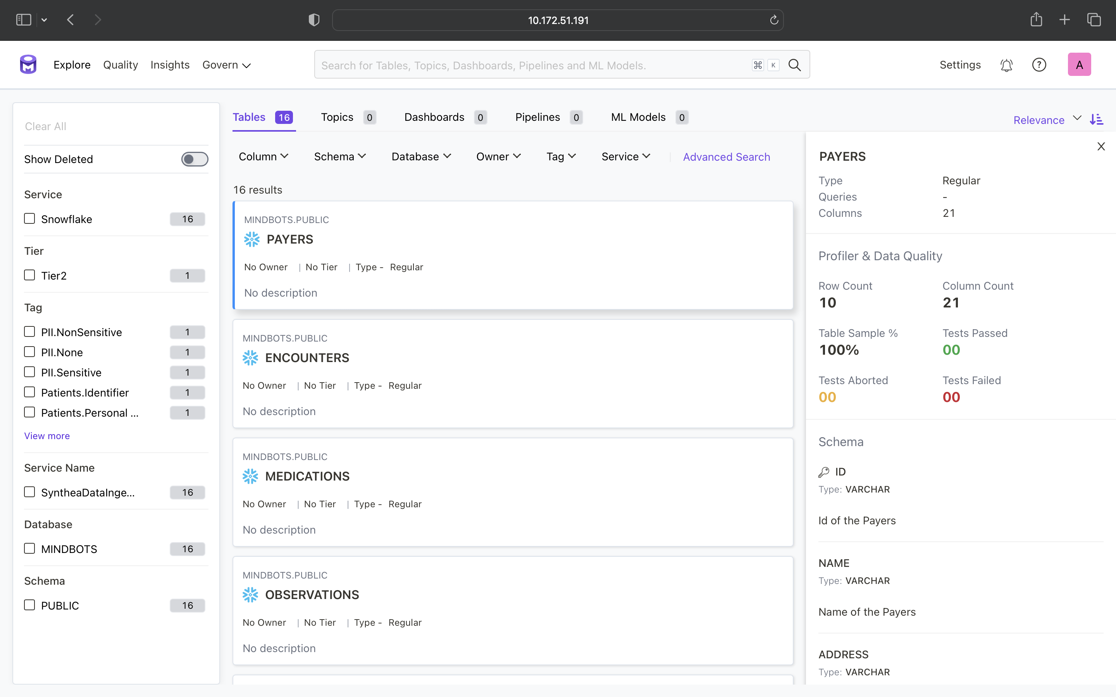
Data Ingested to Open Metadata using Snowflake

Slide 8
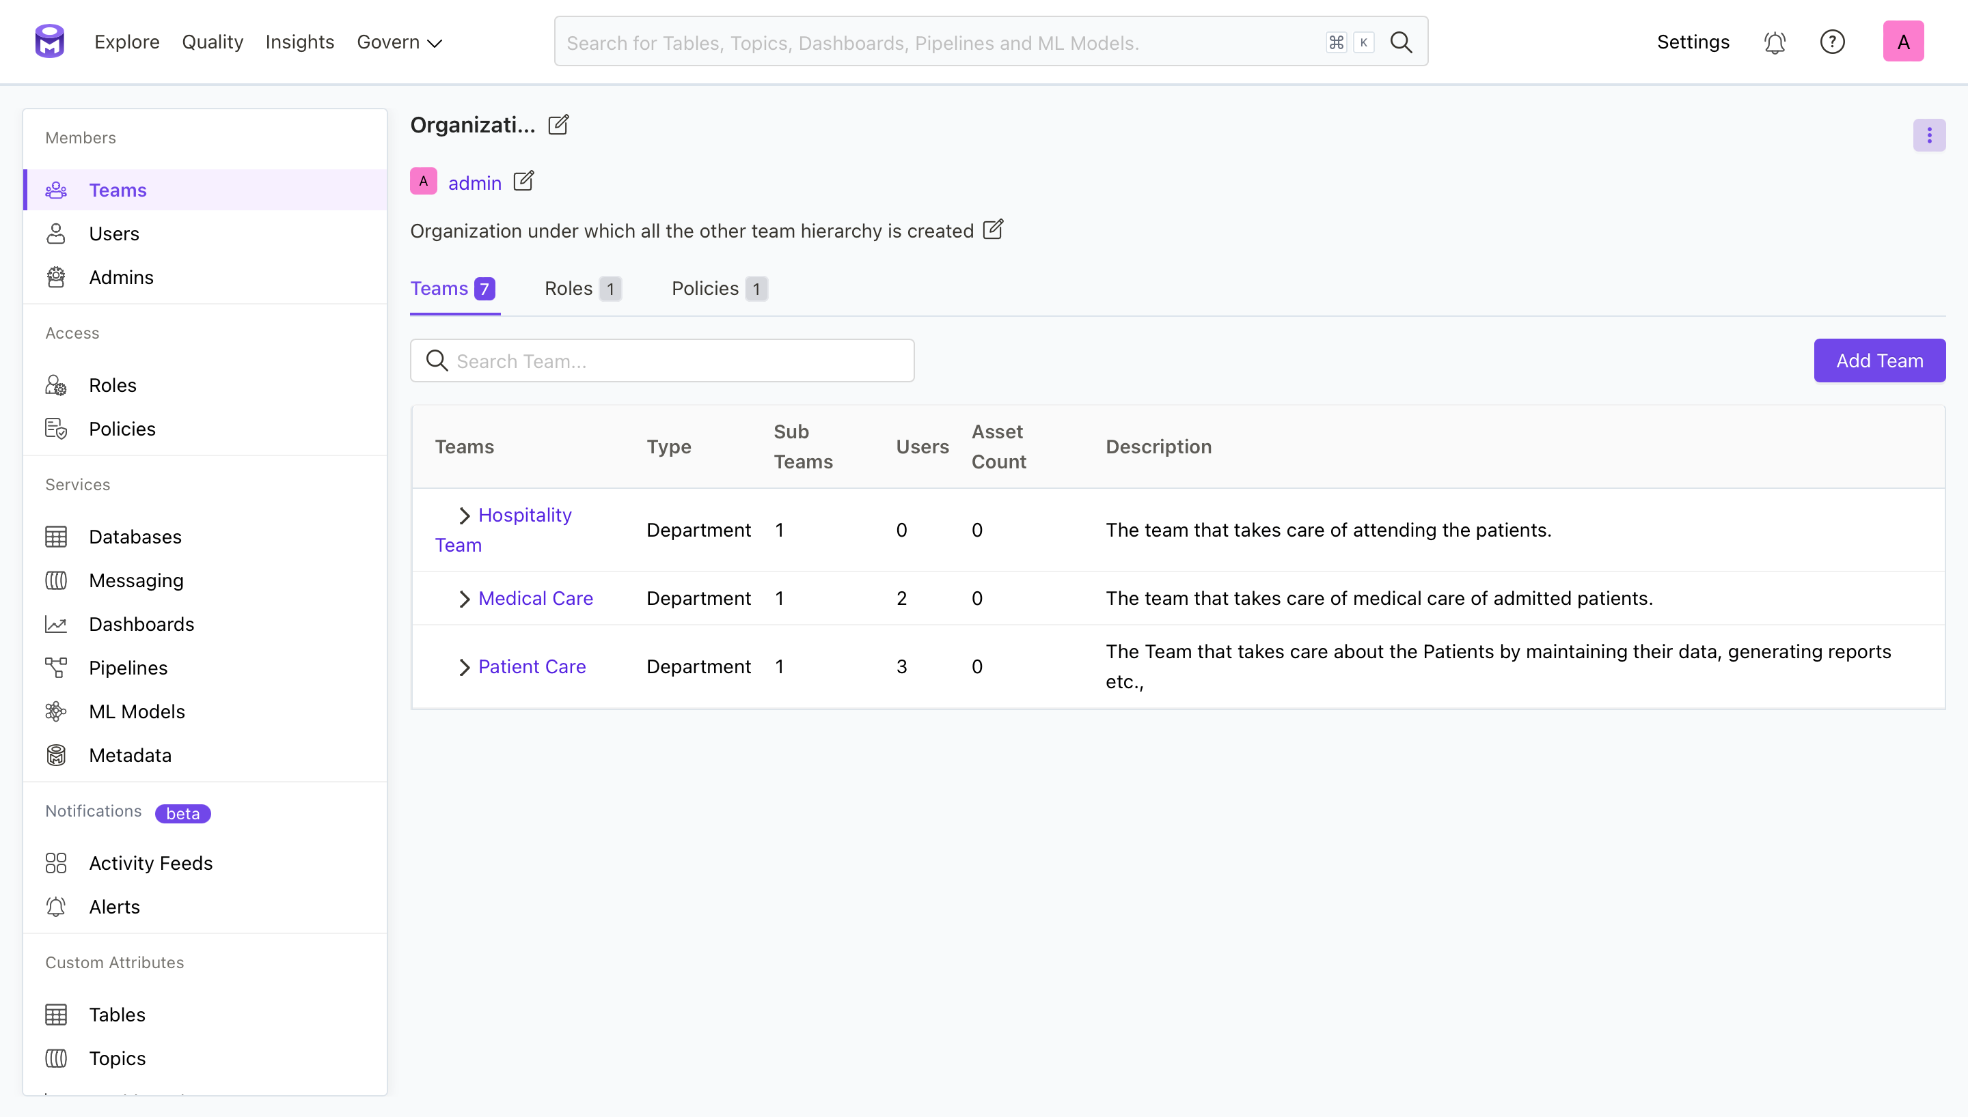
Organization Structure in OpenMetadata

Slide 9
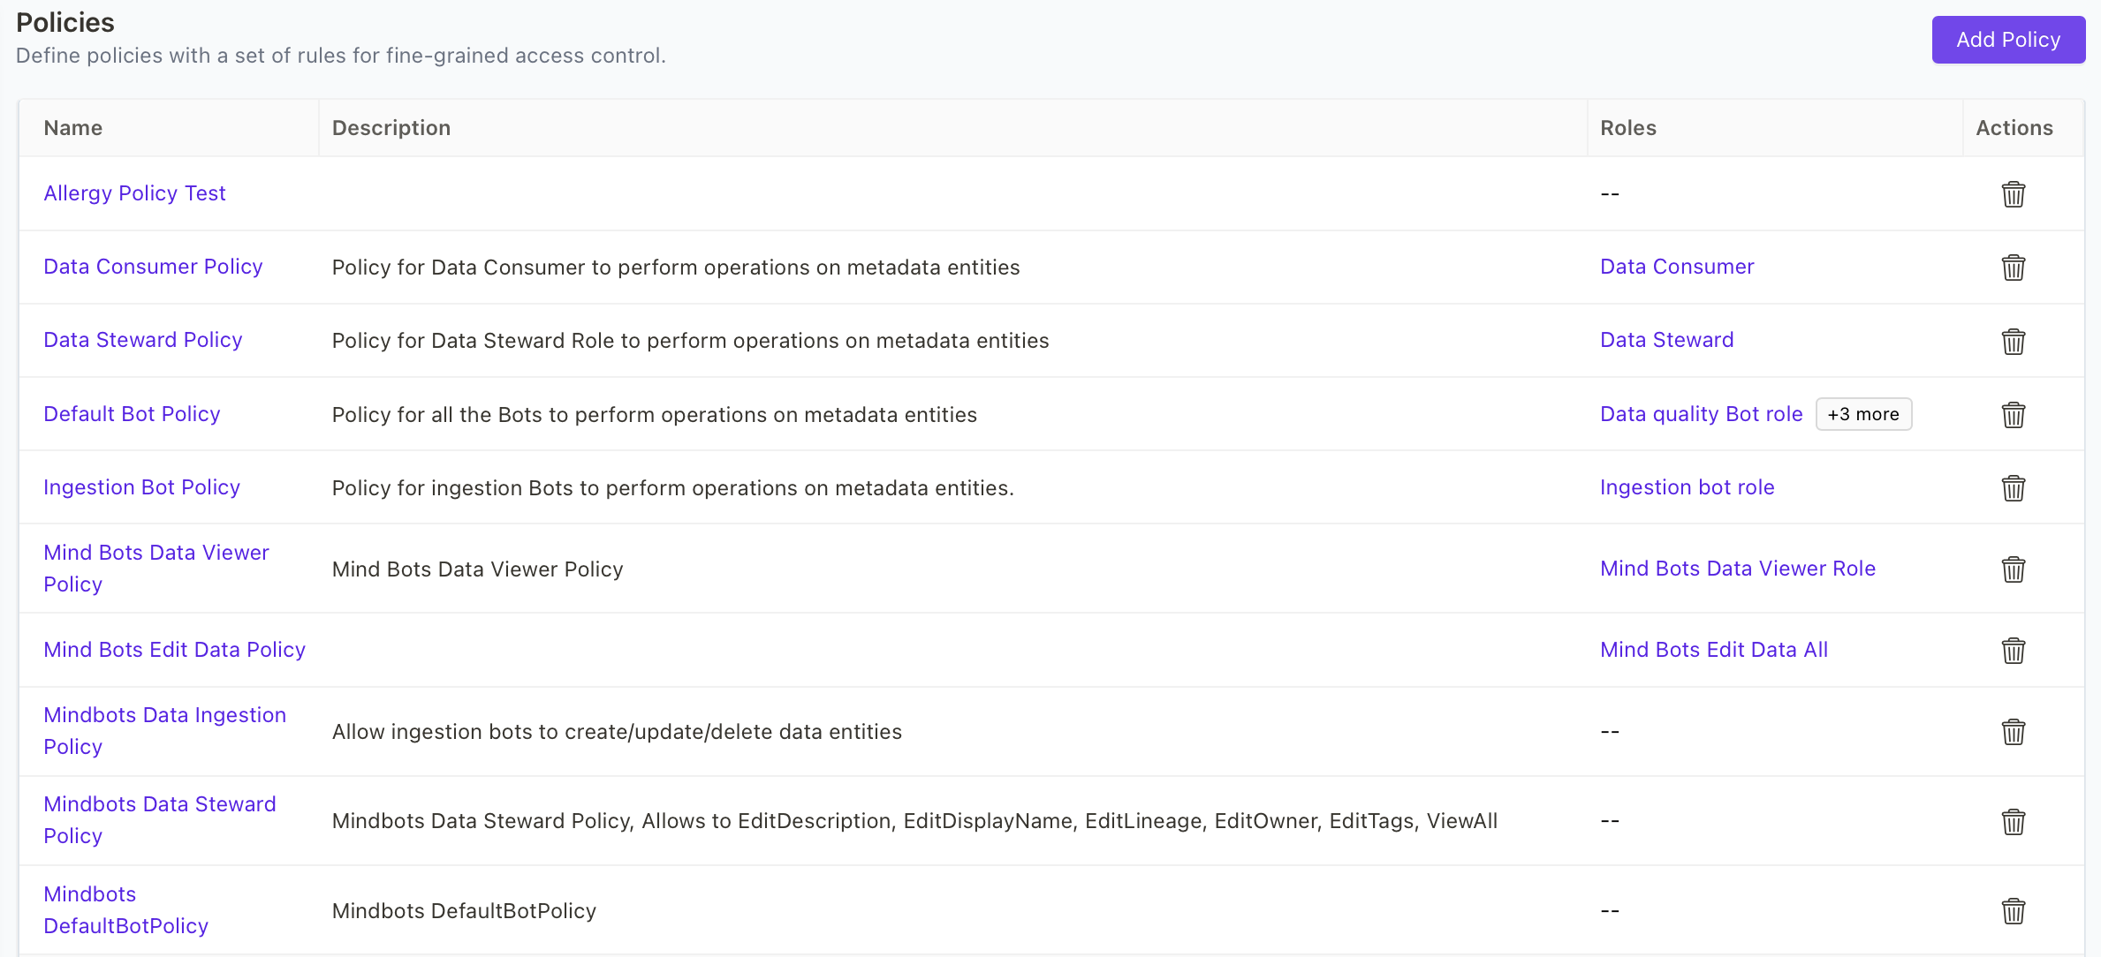
Policies in OpenMetadata

Slide 10
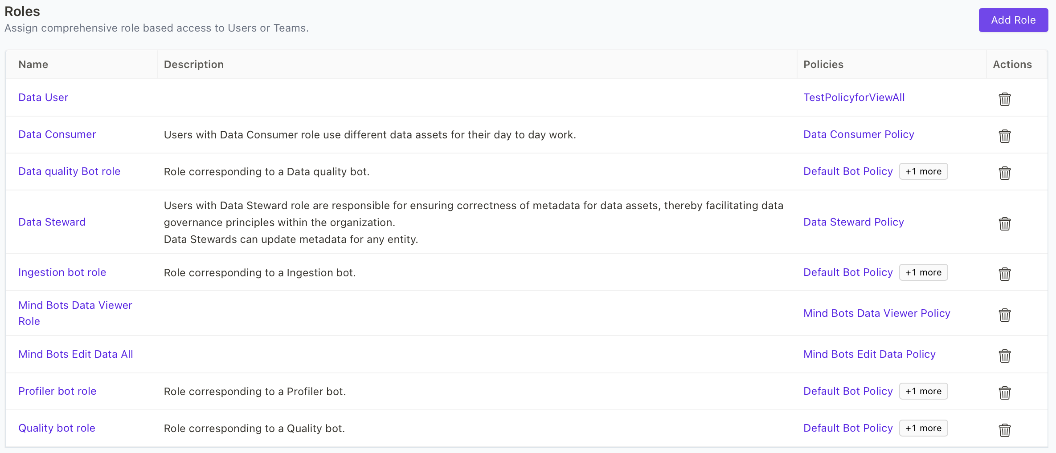
Roles in OpenMetadata

Slide 11
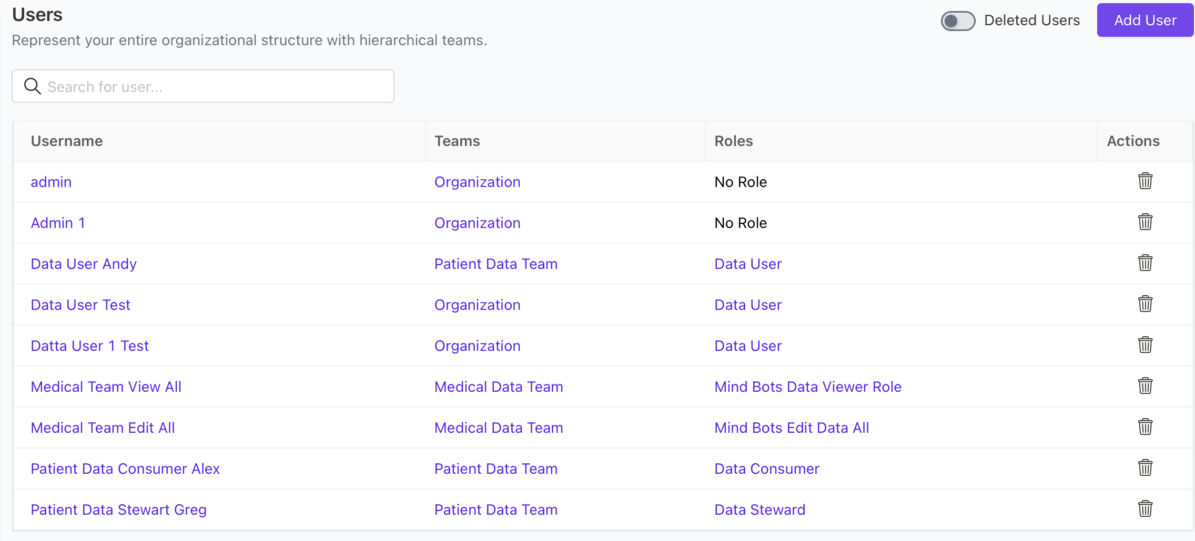
Users Structure in OpenMetadata

Slide 12
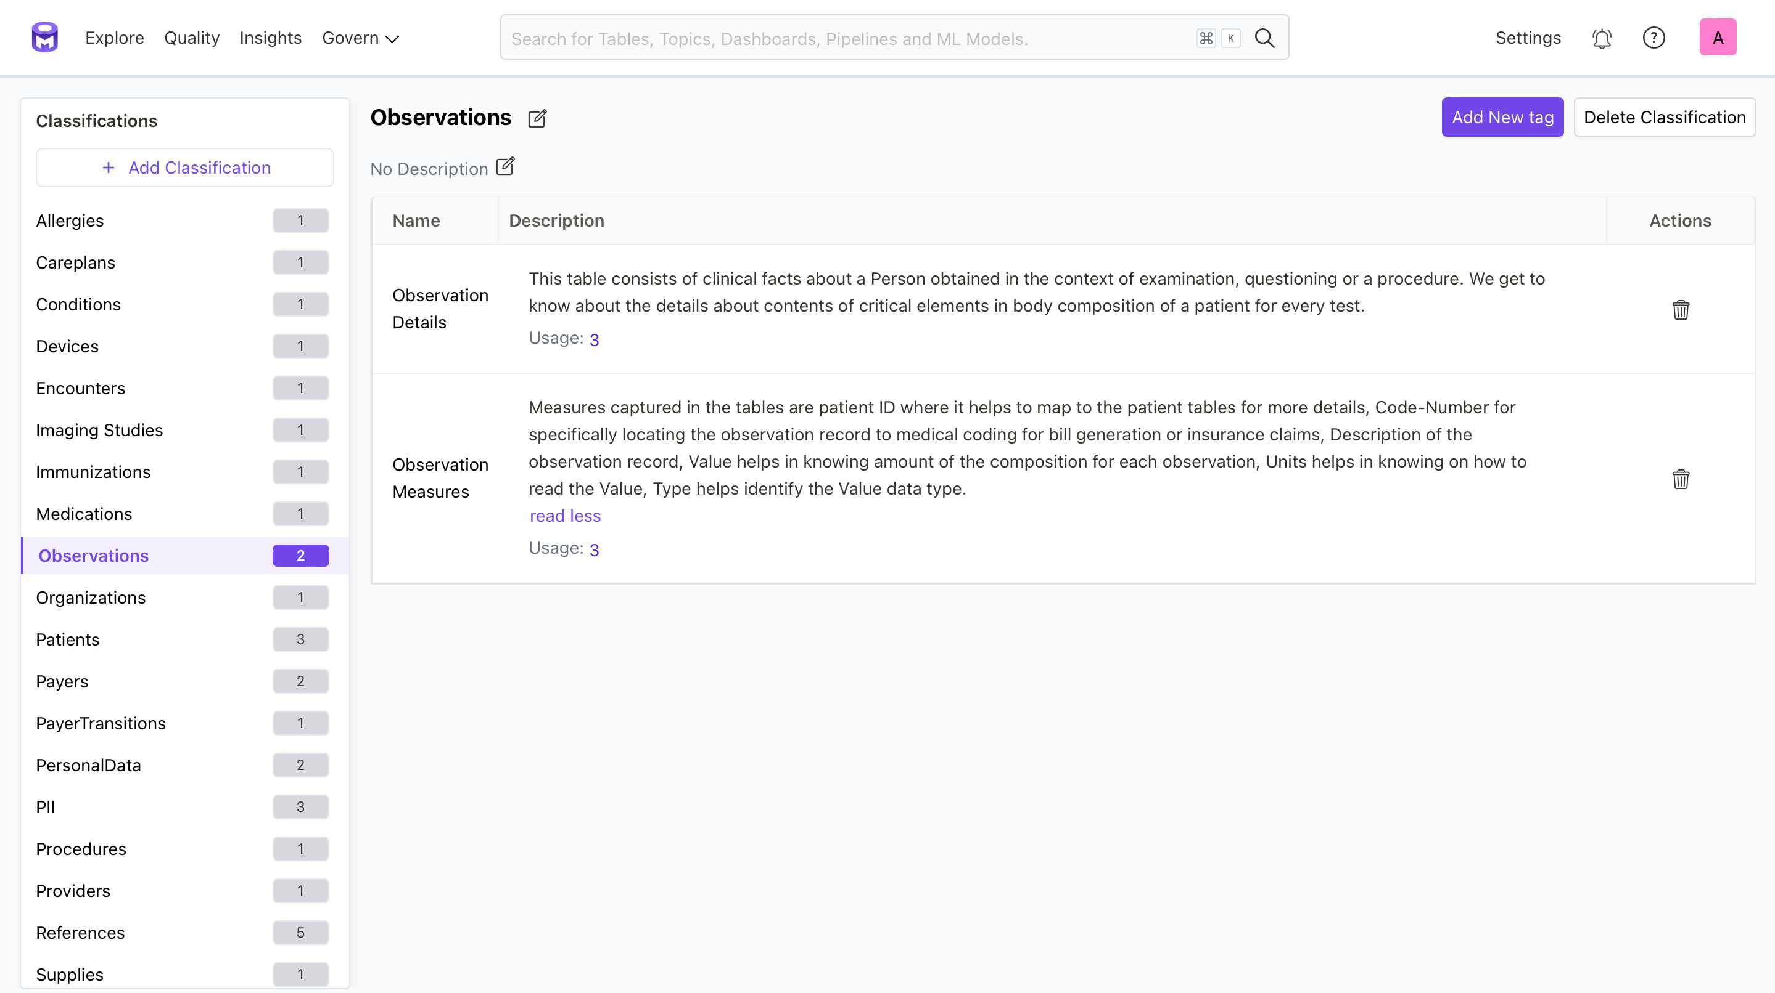
Tags in OpenMetadata

Slide 13
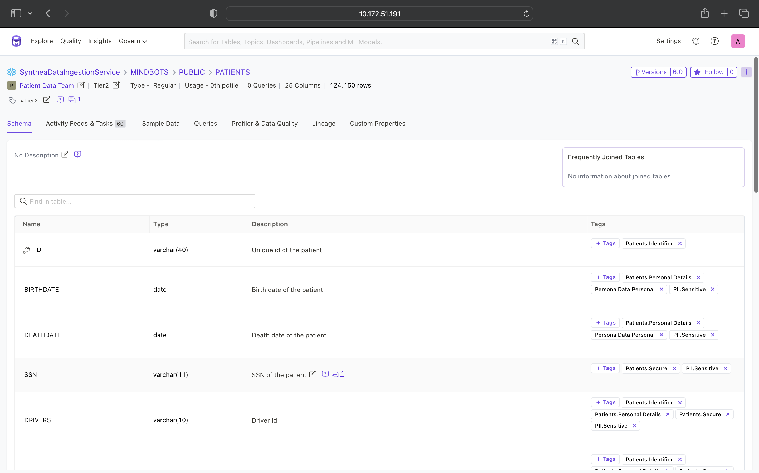
Schema of Ingested Data table

Slide 14
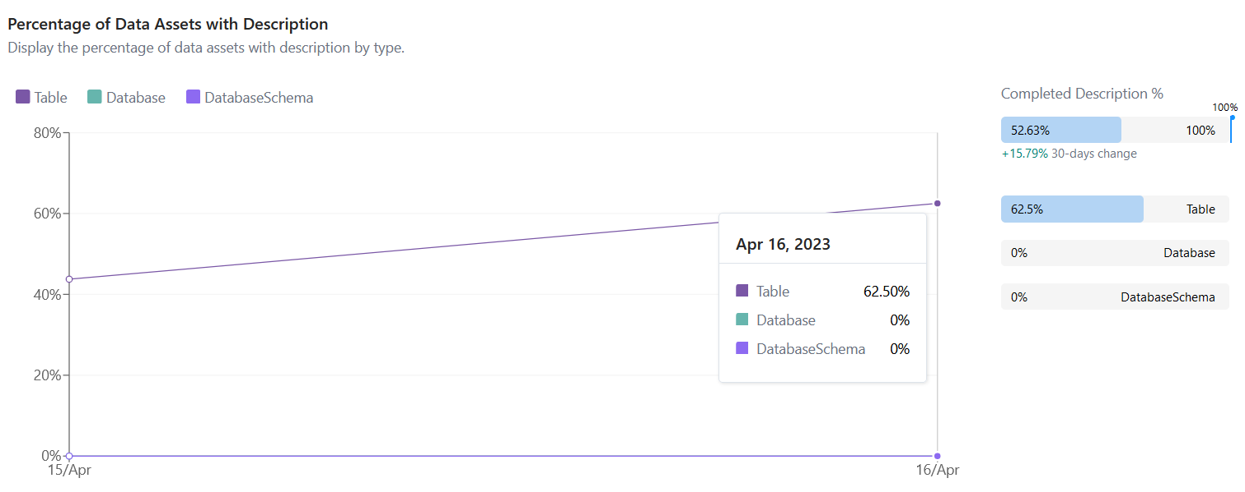
Analytics

Slide 15
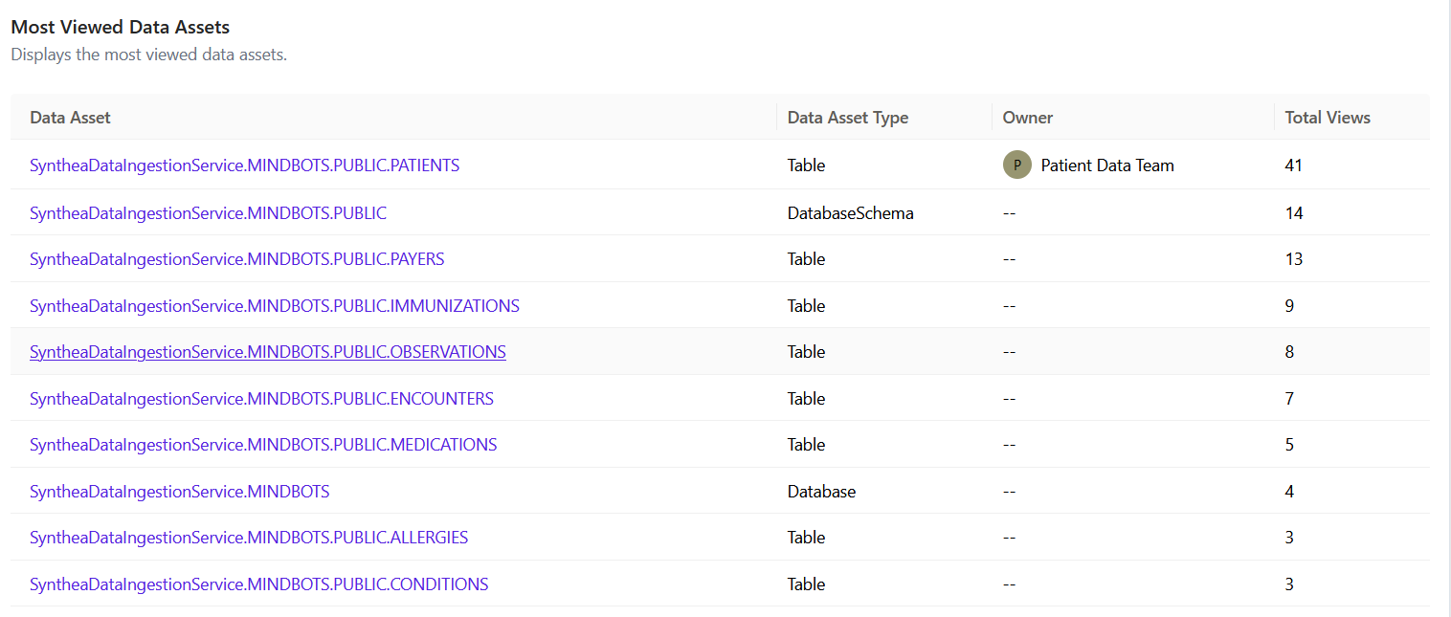
Analytics

Slide 16
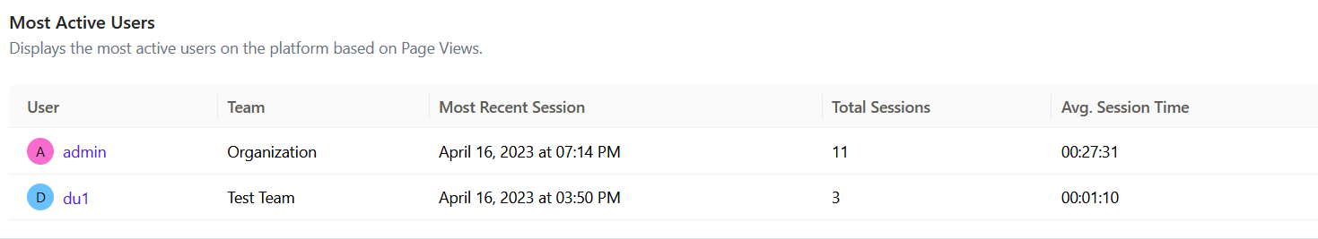
Analytics

Slide 17
Thank You!!

